Slide 1
UCN Fund for
Social Justice
2001 - 2025

Slide 2

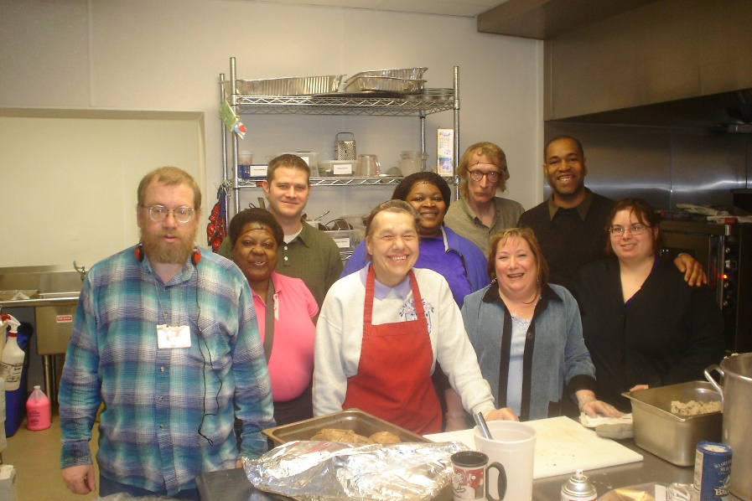
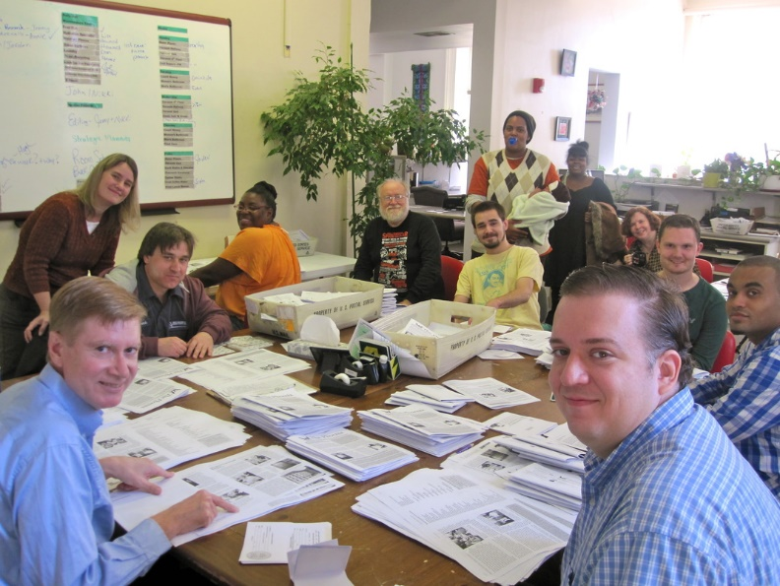
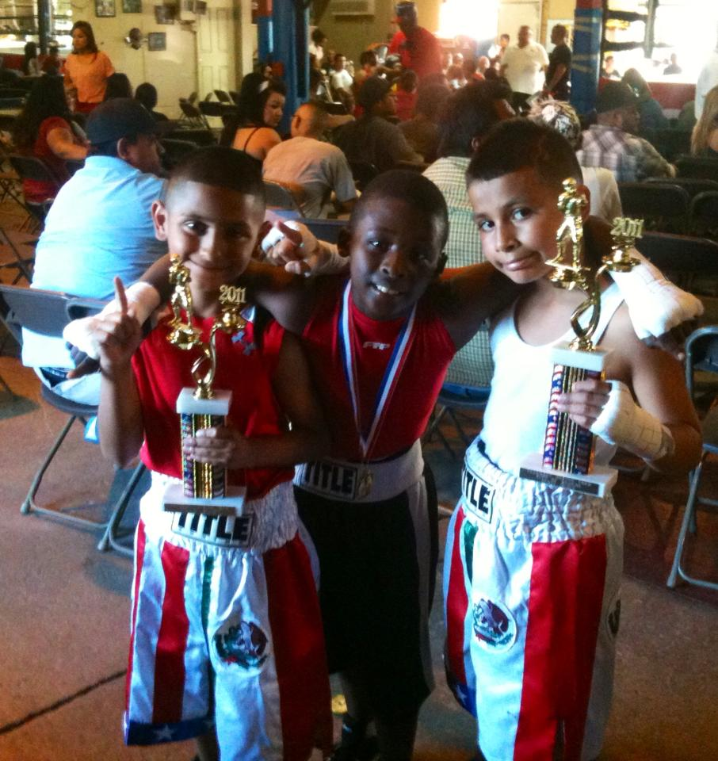
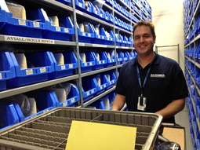
2001: $410.00

Slide 3


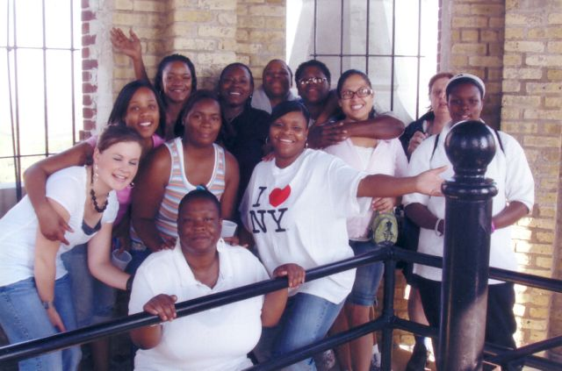
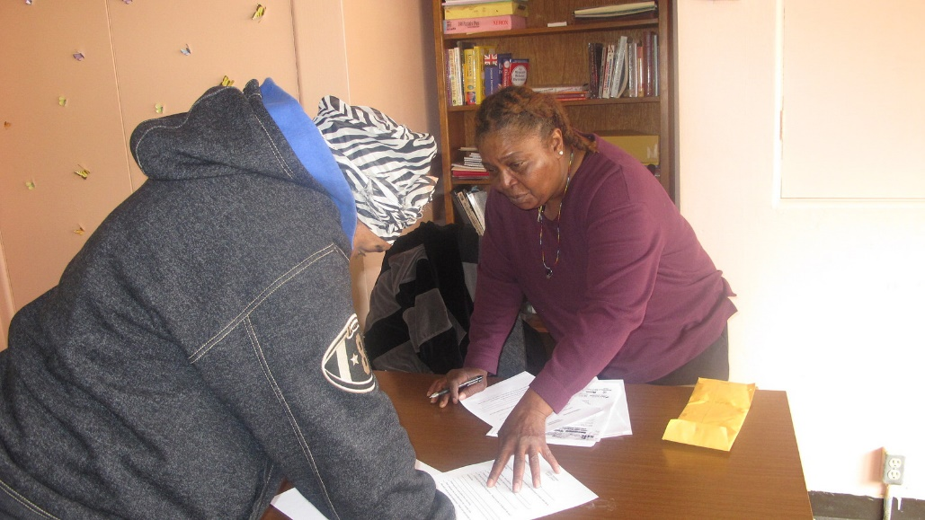
2002: $649.11

Slide 4




2003: $320.94

Slide 5

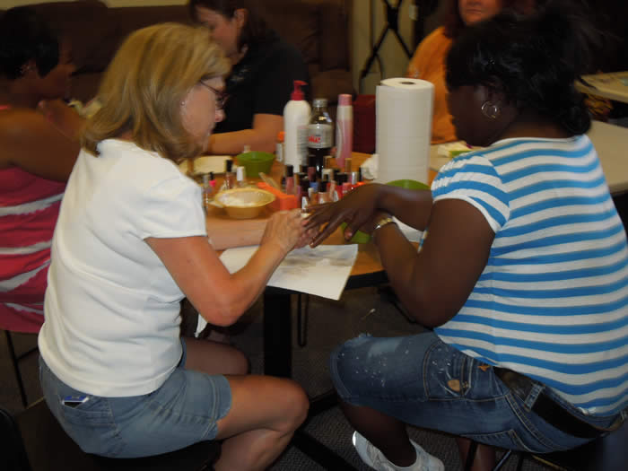

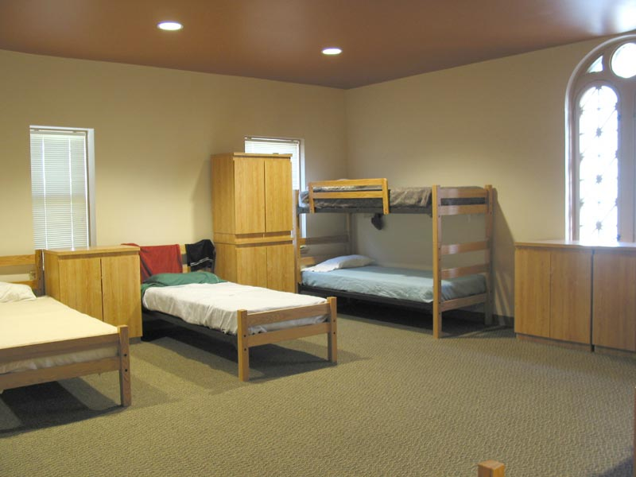
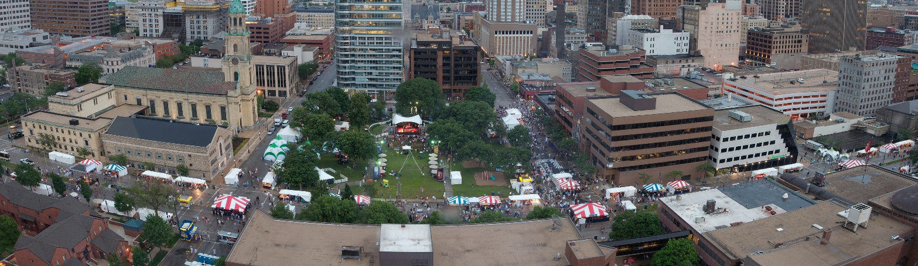
2003: $500.00

Slide 6
2004: $895.44

Slide 7

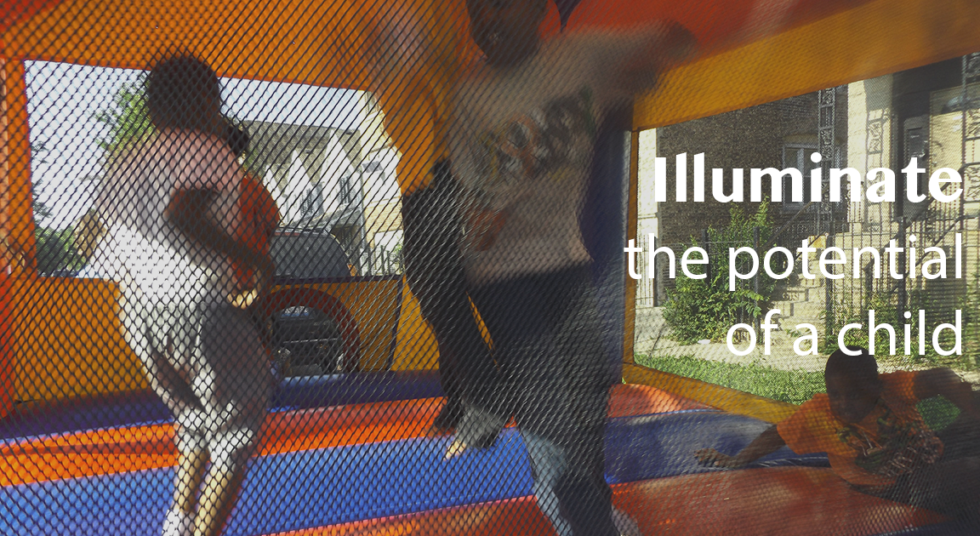
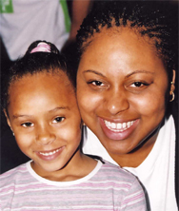
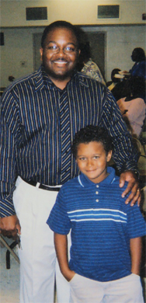
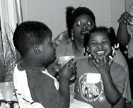
Amachi Program of
Big Brothers/Big Sisters
2005: $863.59

Slide 8


2006: $698.55

Slide 9


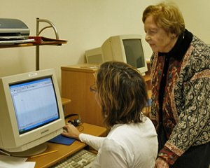

2007: $250

Slide 10


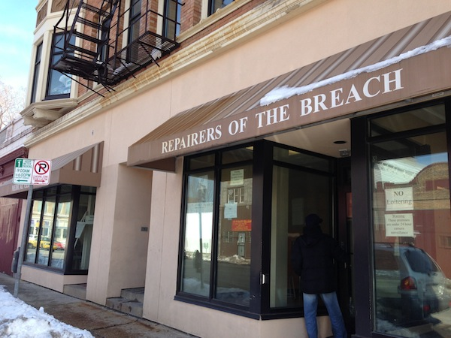
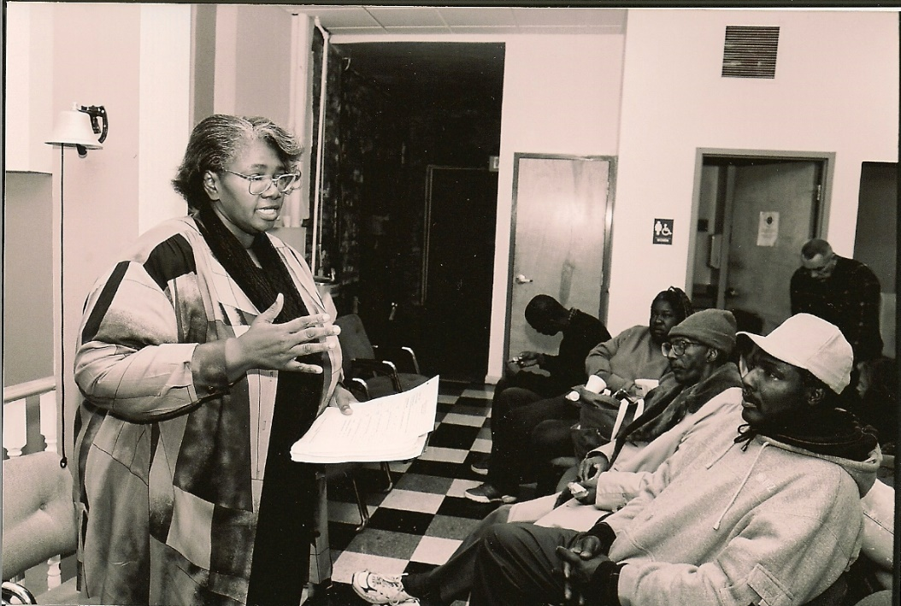
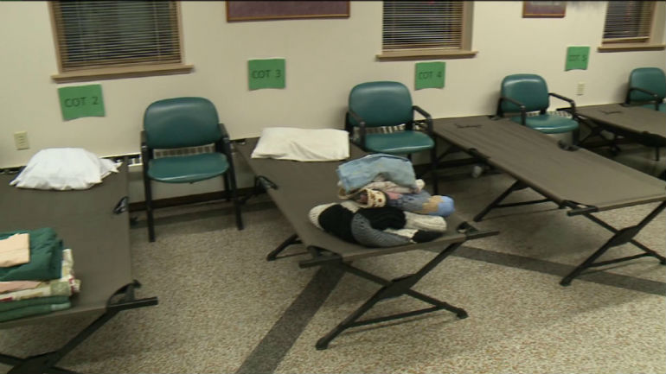
2007: $428.79

Slide 11




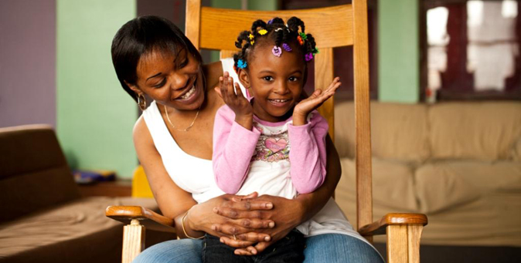
2008: $680.29

Slide 12
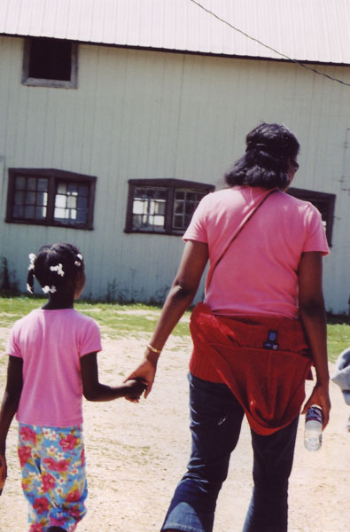

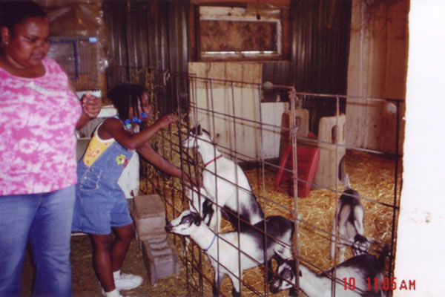
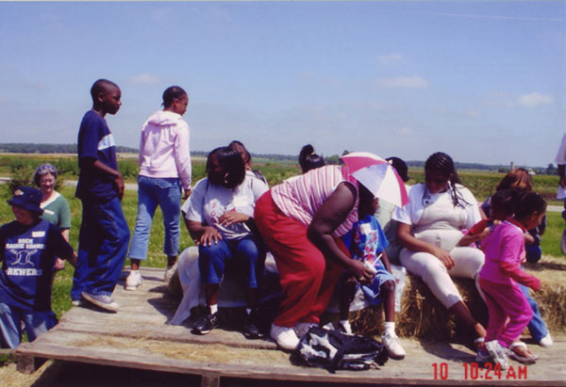
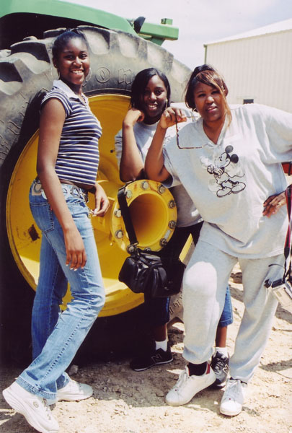
2009: $729.00

Slide 13
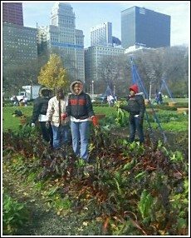
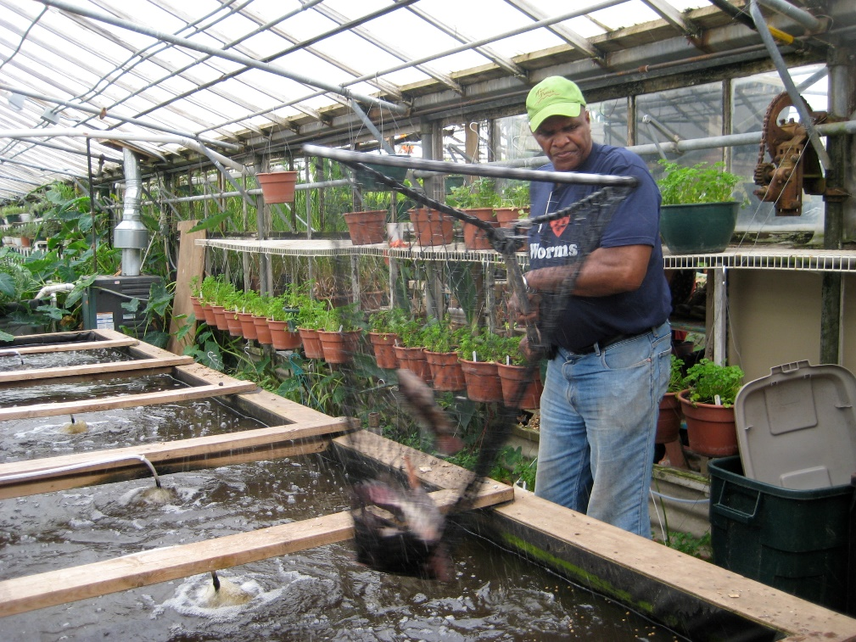

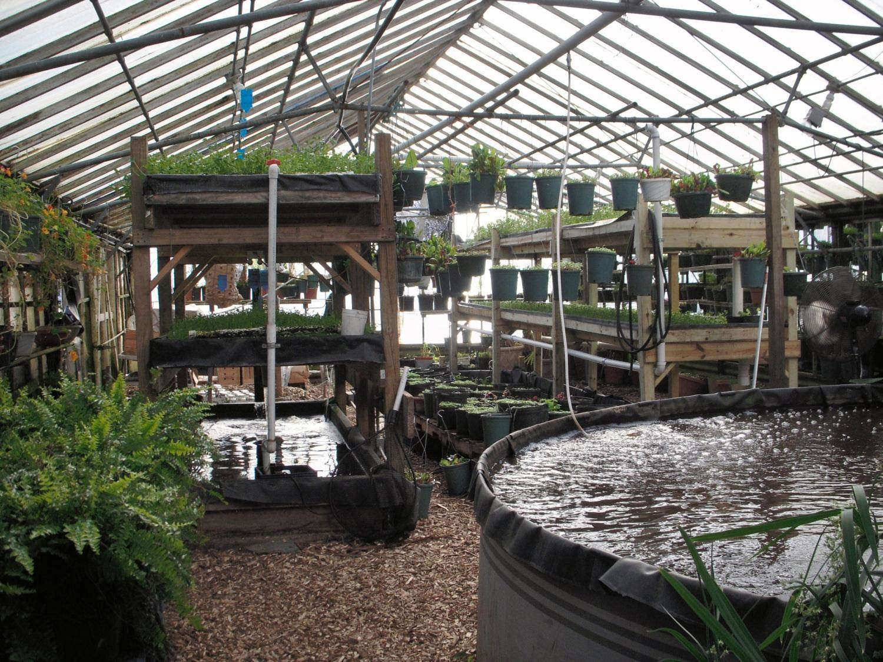
2010: $786.94

Slide 14

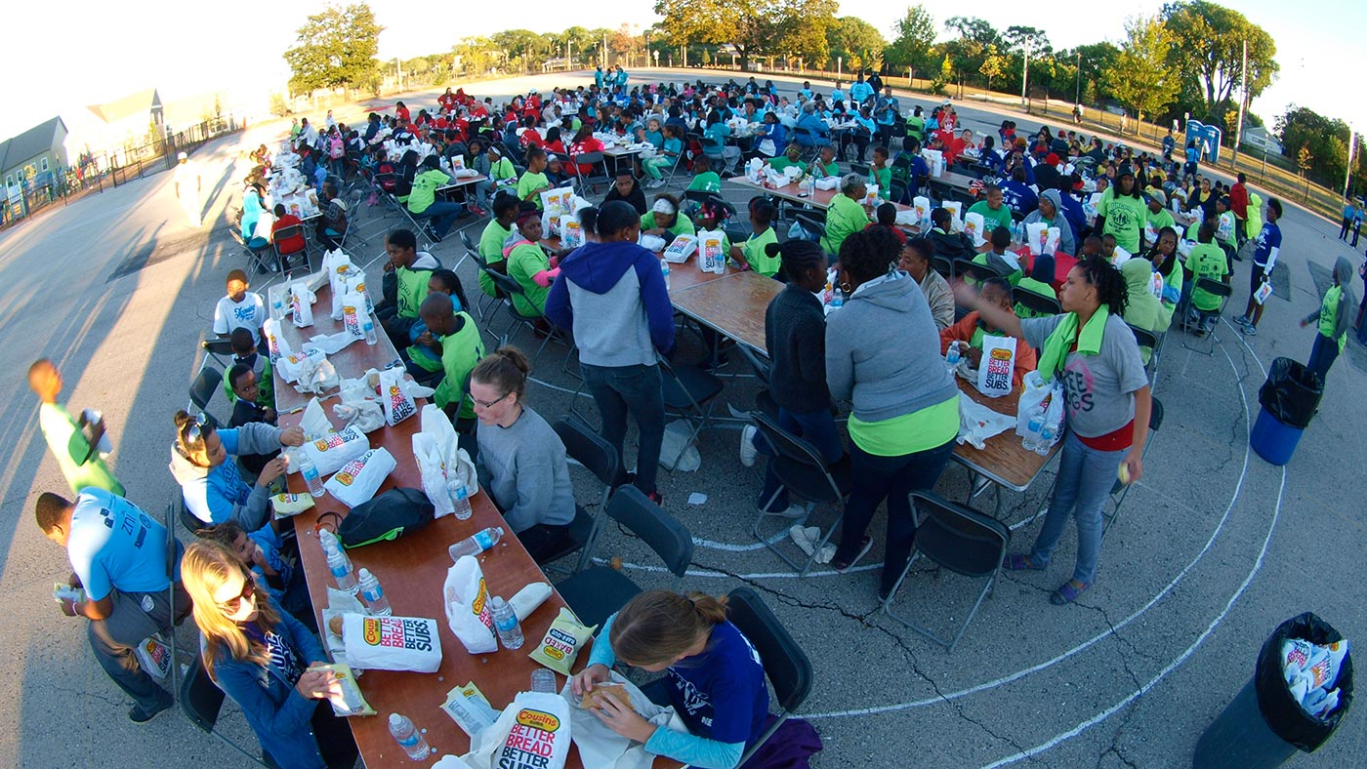
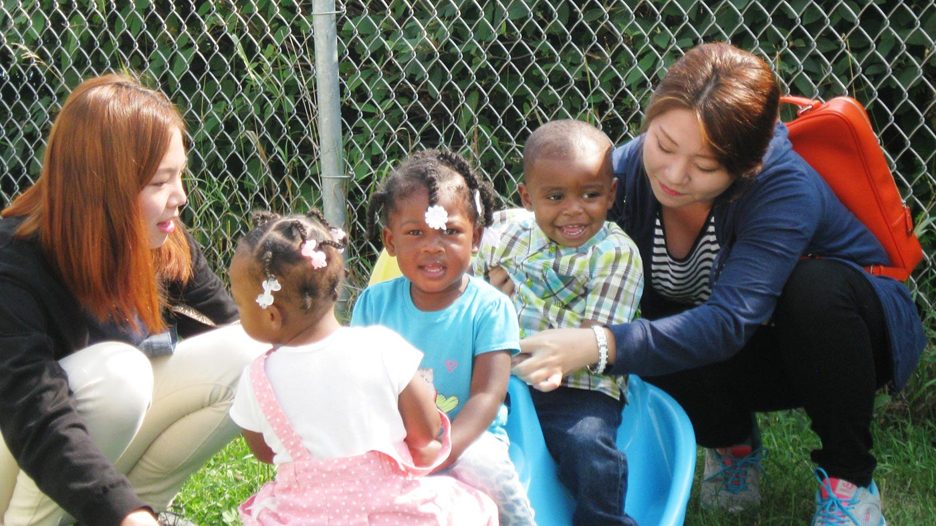
2011: $755.81

Slide 15

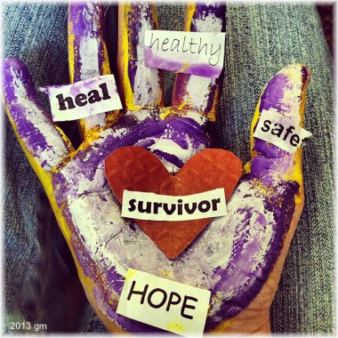
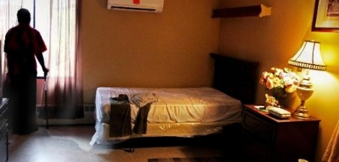
2012: $744.00

Slide 16

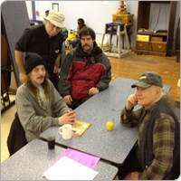
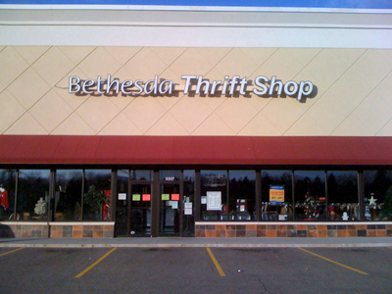
2013: $709.44

Slide 17
2014: $0
No Nominations were Received!
ANY UCN member may nominate an organization for consideration.
Find the nomination form at ucnorth.org, Social Justice, or pick up one from the upstairs lobby.
Complete and hand in the nominating paperwork to UCN’s office by January 15.

Slide 18

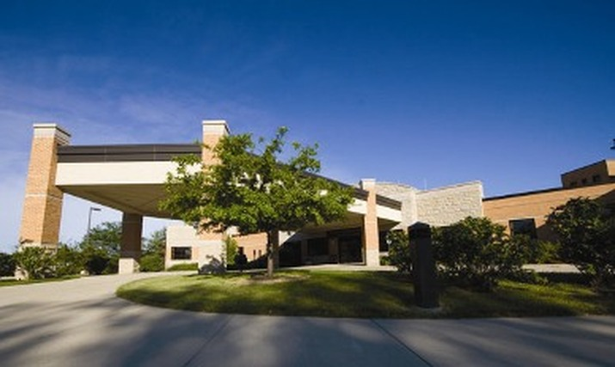
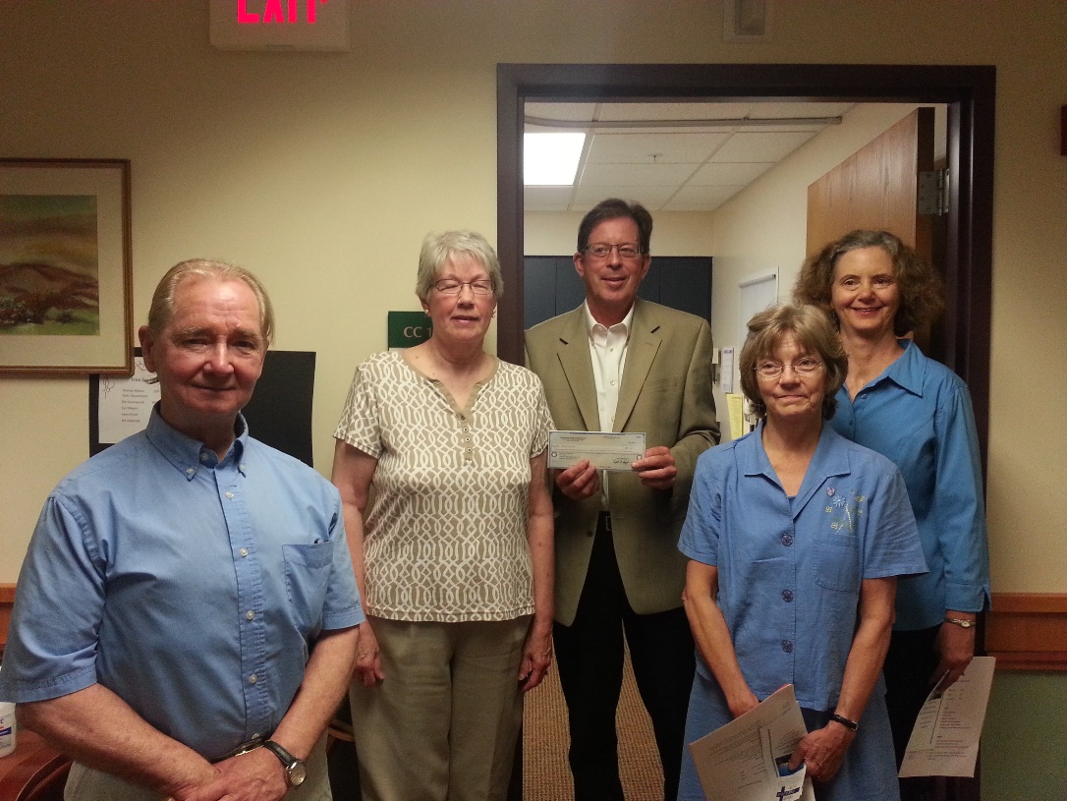
2015: $1,421.11

Slide 19


2016: $729.28

Slide 20

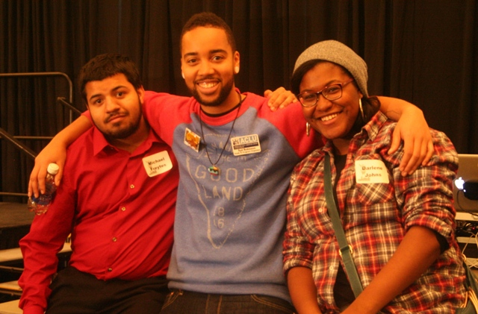
AMERICAN CIVIL LIBERTIES UNION
STUDENT ALLIANCE
2017: $767.00

Slide 21





2018: $787.52

Slide 22



Milwaukee Inner City Congregations Allied for Hope
2019: $806.32

Slide 23
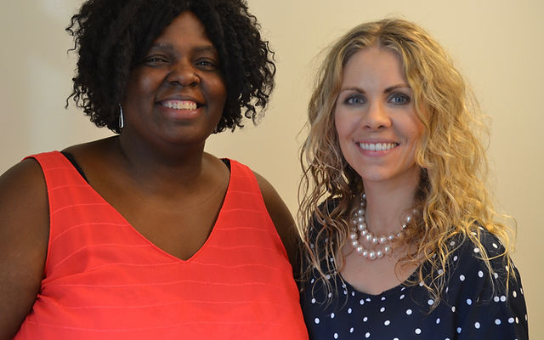


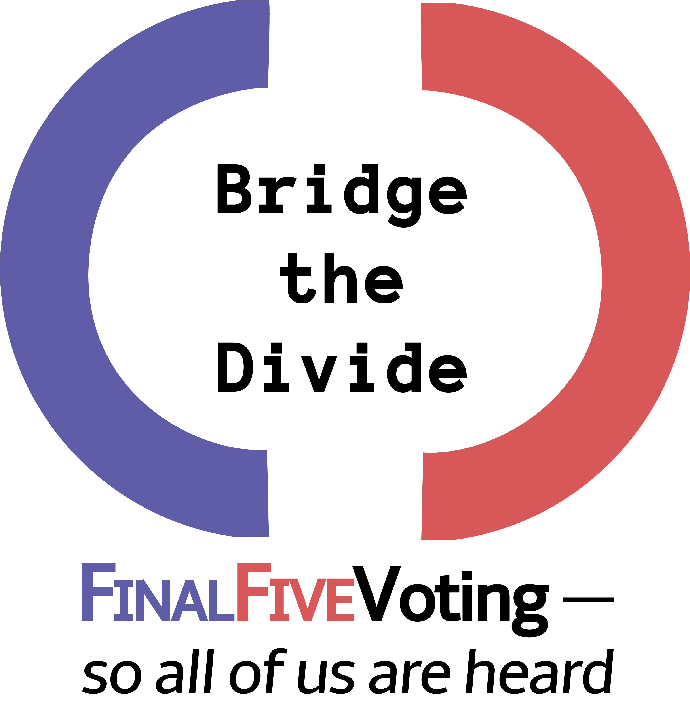
Bridge the Divide, Cedarburg
2020: $841.14

Slide 24


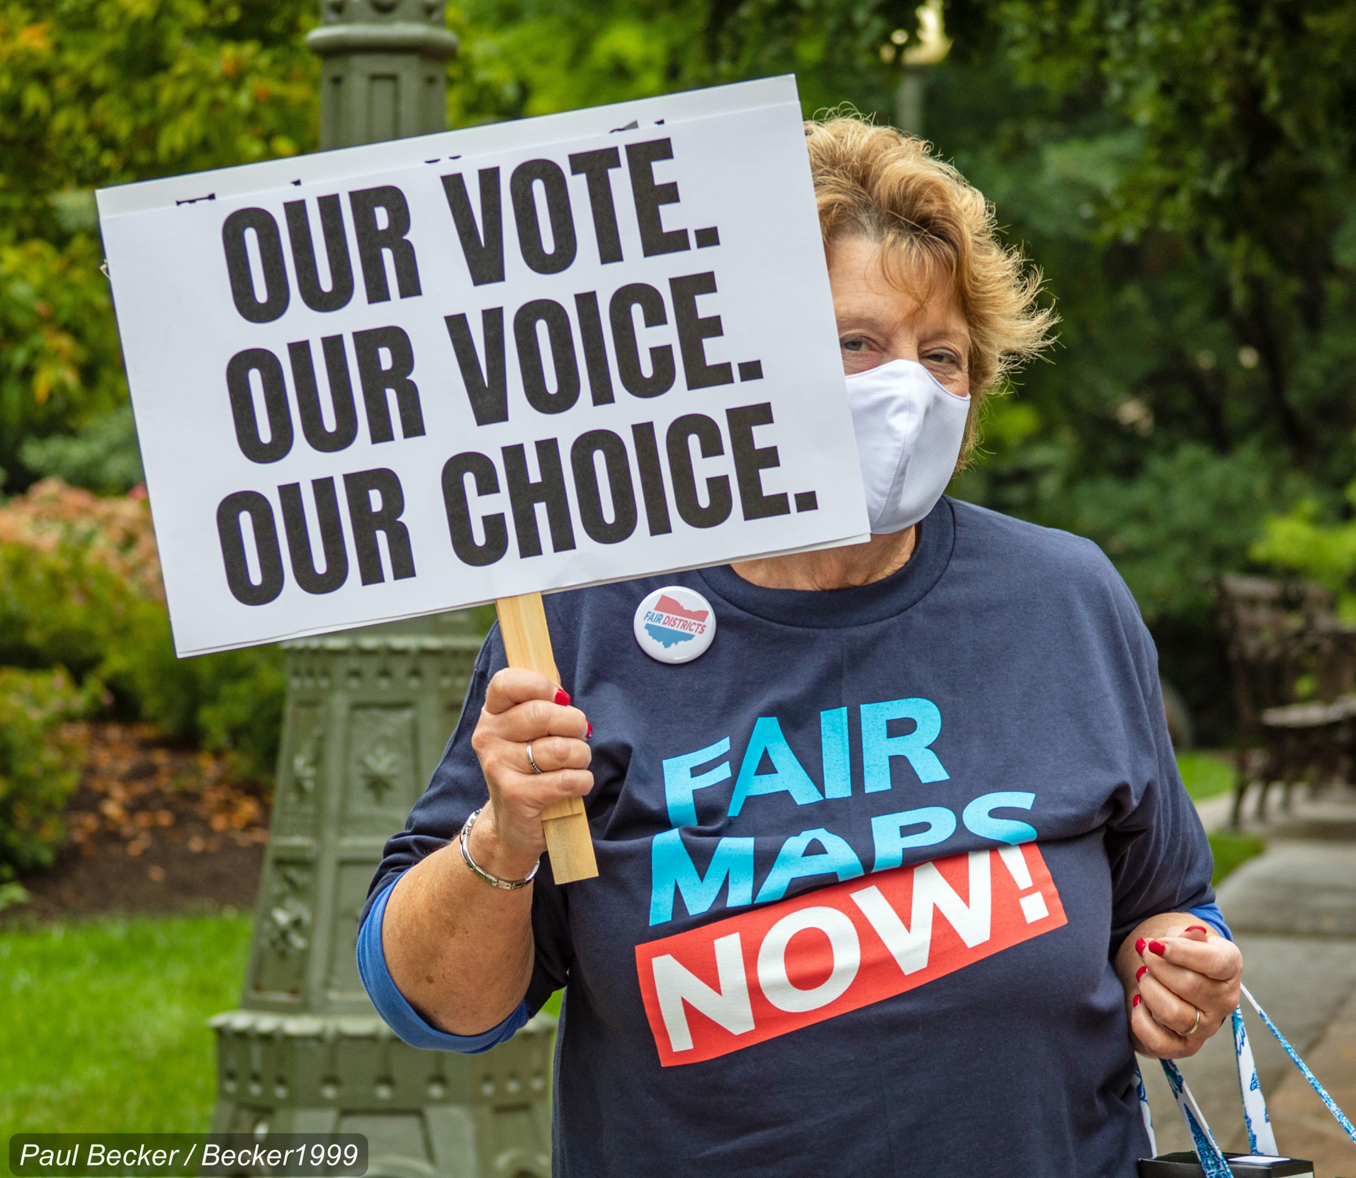
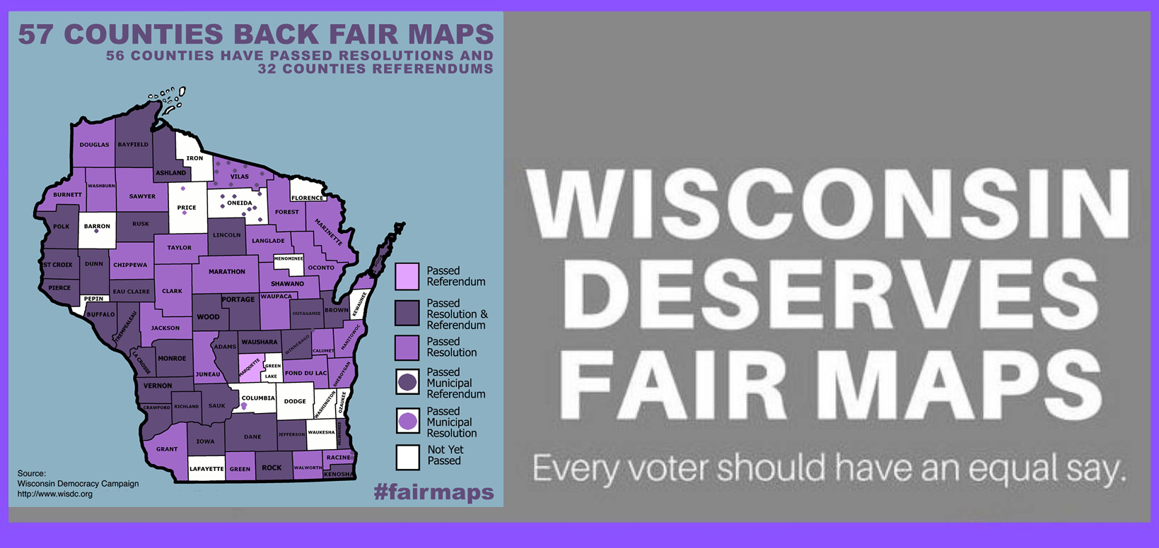
Wisconsin Fair Maps Coalition
2021: $869.33

Slide 25



2022: $922.42

Slide 26
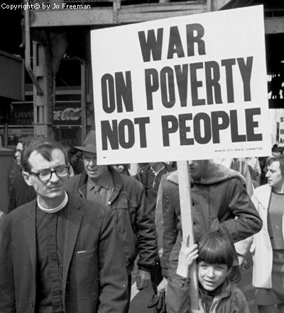
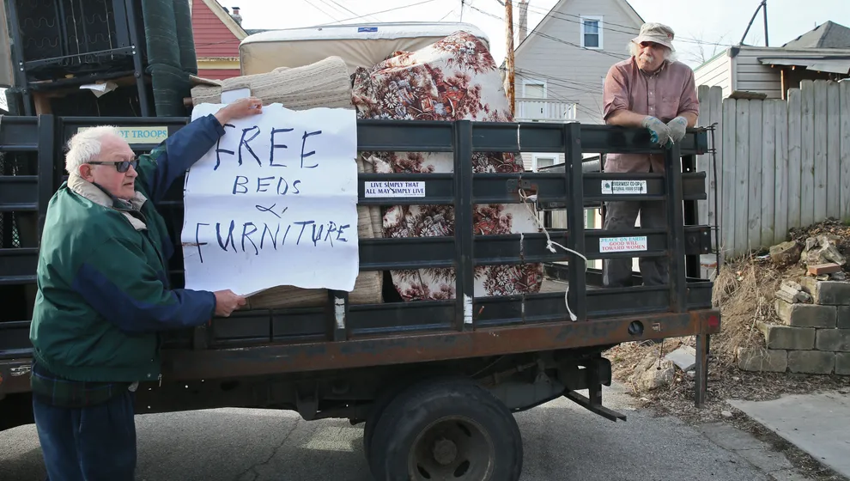
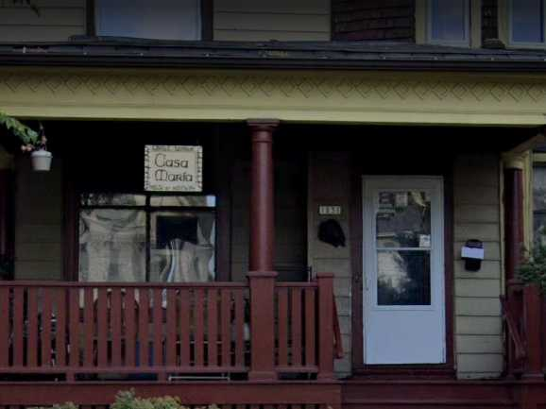
Casa Maria Catholic Workers, Milwaukee Chapter
2023: $967.68

Slide 27

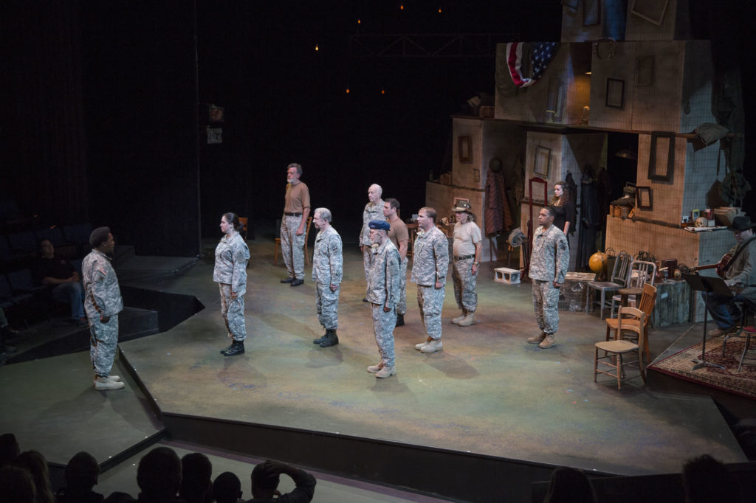

2024 Nominee, $1,036.31

Slide 28
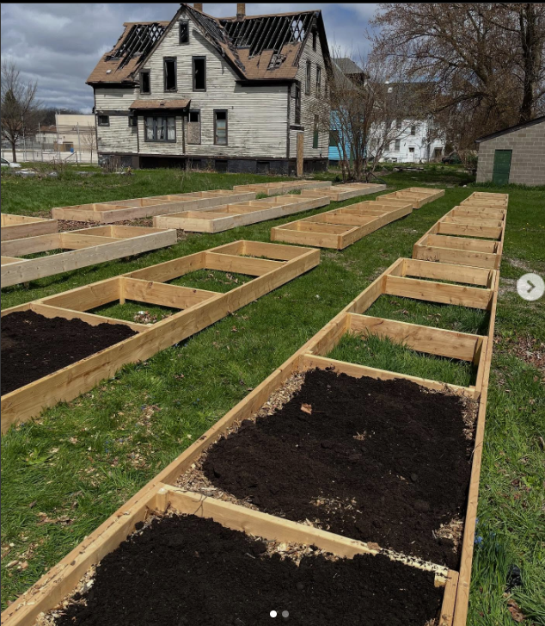
We Got This Community Garden
Milwaukee
$1,234.50
2024 Nominee

